Slide 1
Making Disaster Mental Health Part of a CP Training Program
Sharon L. Bowman, PhD, HSPP, ABPP, LMHC

Slide 2
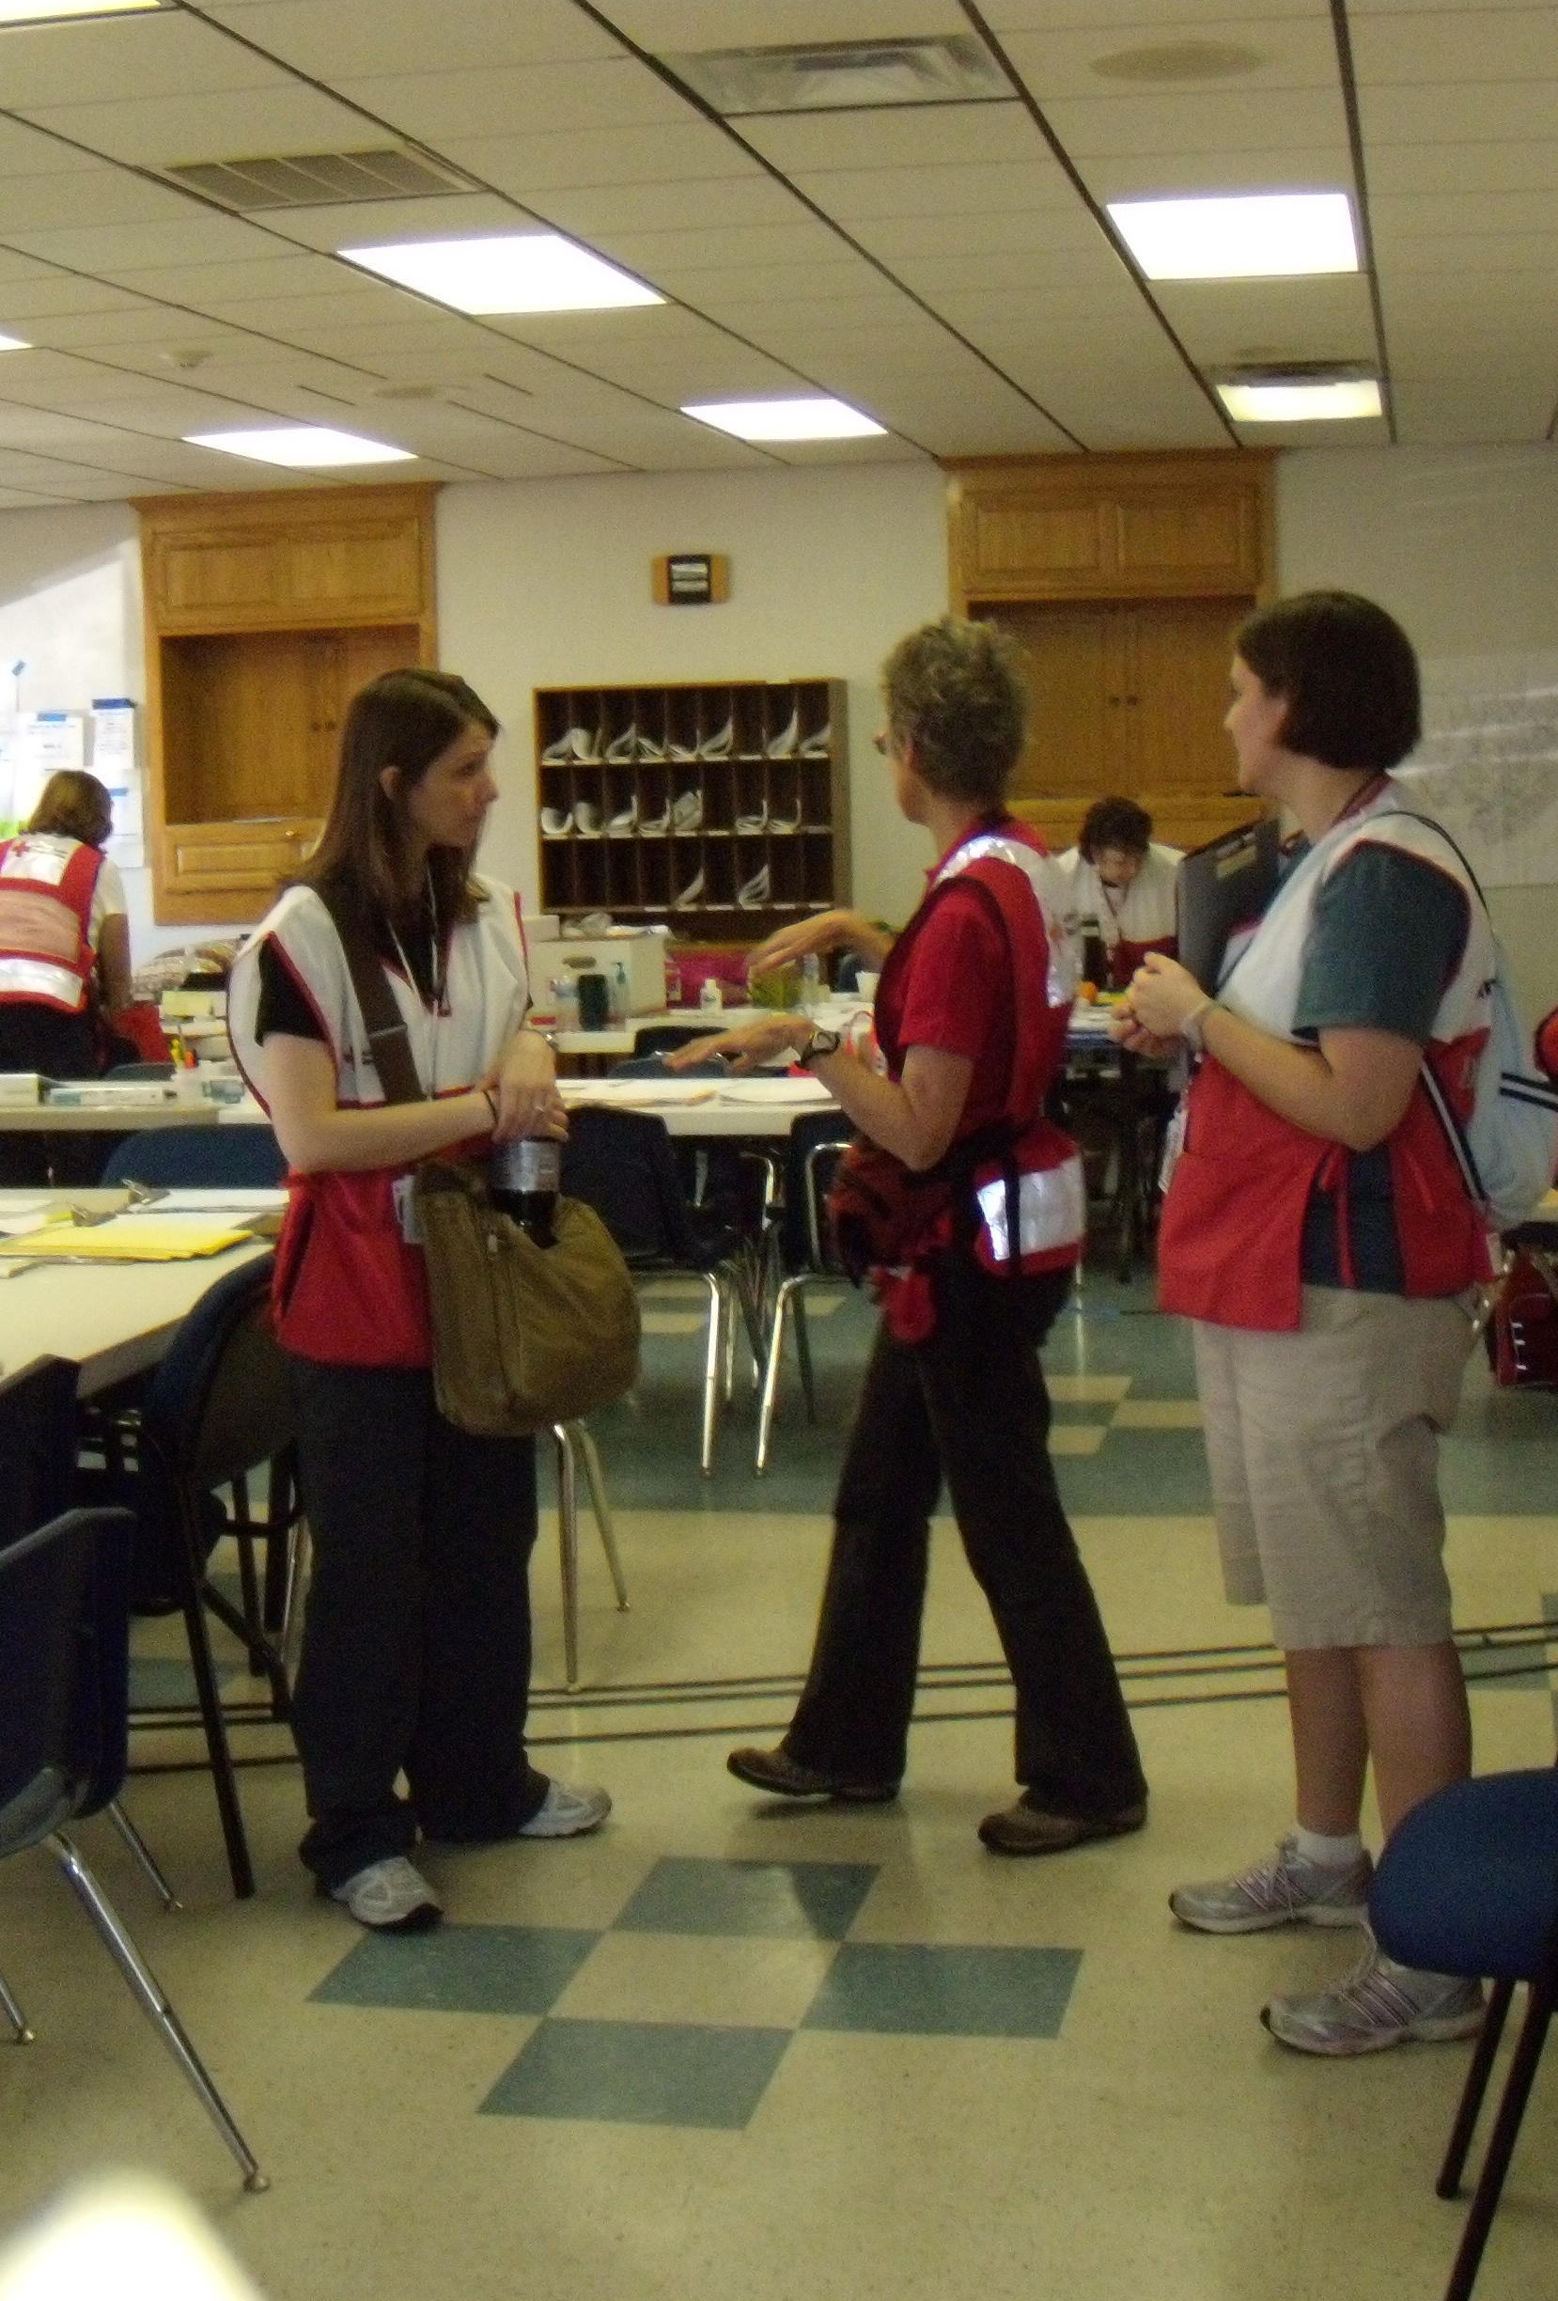
Alabama 2011
Looking for a new opportunity for yourself and your students?

Slide 3
Program Objectives
Describe the role of disaster mental health (DMH) in a social justice mission
Explain the role and function of DMH within disaster organizations such as the American Red Cross
Explain ways graduate students can provide DMH services locally and nationally
Understand how to seek contacts in their home areas for further information and training

Slide 4
My qualifications
Licensed psychologist (1990) and LMHC (2000)
CISM trained (1996)
ARC disaster mental health volunteer (1996-ish)
ARC disaster mental health instructor (2005-ish)
D17’s first Emergency Response Coordinator
Indiana Disaster Response Network liaison

Slide 5
Thanks go to:
John Snyder (SIU-C); indirectly, he exposed me to this work
Robert Hayes (BSU); he tended to drag me into trouble with him

Slide 6
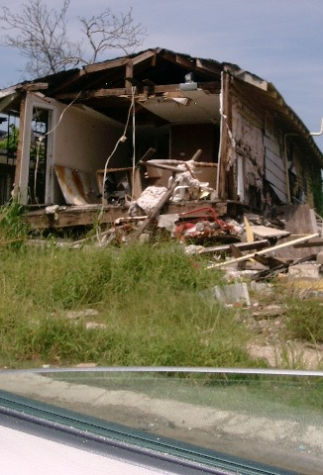
Katrina 2005
Why do I do this?

Slide 7
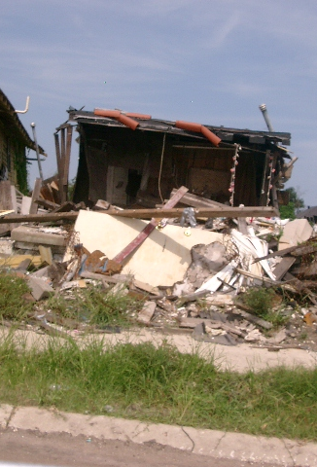
Katrina 2005

Slide 8
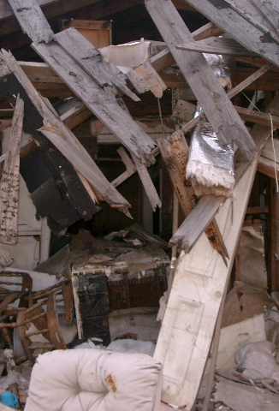
Katrina 2005

Slide 9
What is Disaster Mental Health?
It is the provision of mental health support to survivors and DMH workers throughout the course of a disaster and its recovery.
That may include Psychological First Aid, advocacy, outreach, and/or educational activities
IT DOES NOT INCLUDE LONG TERM COUNSELING OR DIAGNOSIS

Slide 10
FEMA Crisis counseling & assistance program
This is a FEMA-funded and operated program providing mental health assistance in areas designated by the President as a disaster area.
National Organization for Victim Assistance (NOVA)
NOVA Crisis Response Teams provide trauma mitigation, education and emotional first aid after a critical incident (small-scale or mass casualty). This is broader than MH training, and comes at a cost ($325?)

Slide 11
Individualized programs
Gargi Roysircar’s disaster counseling team at Antioch New England. “Free-lancing” gives you lots of options, both nationally and internationally, but may offer some risks, too.
American red cross dmh training
Standardized training model
For mental health professionals (and students)
And it is basically free!

Slide 12
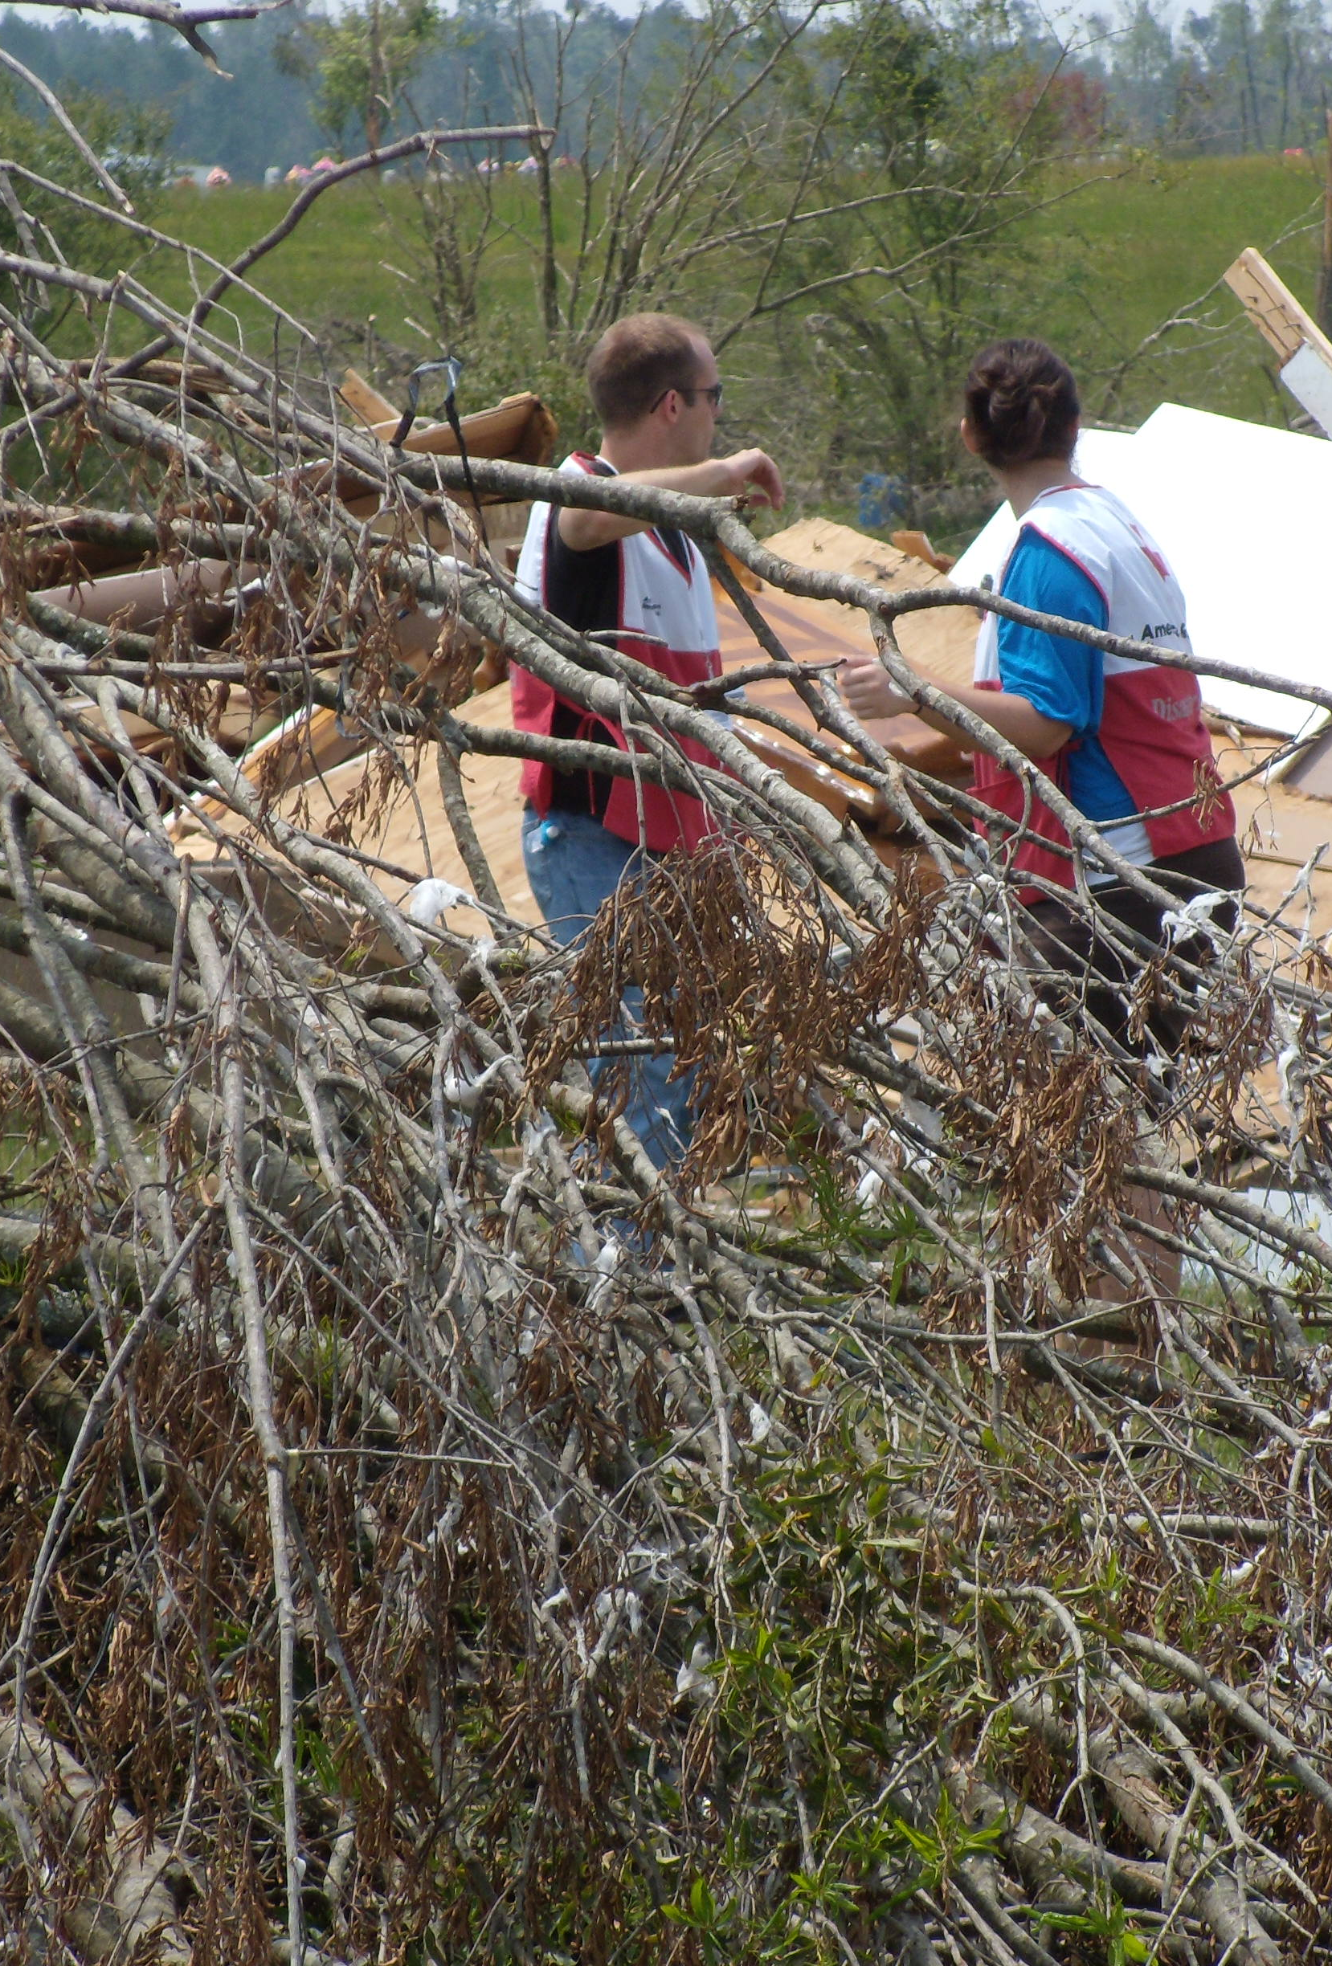
ARC DMH
What does this entail?

Slide 13
For national disaster assignment
Complete the ARC training modules
Get registered with ARC
Willing to travel for a minimum of 10 days (MH assignments are shorter than other volunteers)
be licensed for independent practice
Travel costs paid by ARC

Slide 14
Participating locally
Same requirements re: training and licensure
Must be in contact with your local chapter, and probably the state DMH lead
Participation can be as little as a phone call or as much as a day or two on site

Slide 15
How are students involved?
They do not have to be licensed themselves, but they must be under supervision of a DMH-trained professional
For national travel, no more than 5 students per supervisor
For local disasters, management can be more “flexible,” depending on your locale

Slide 16
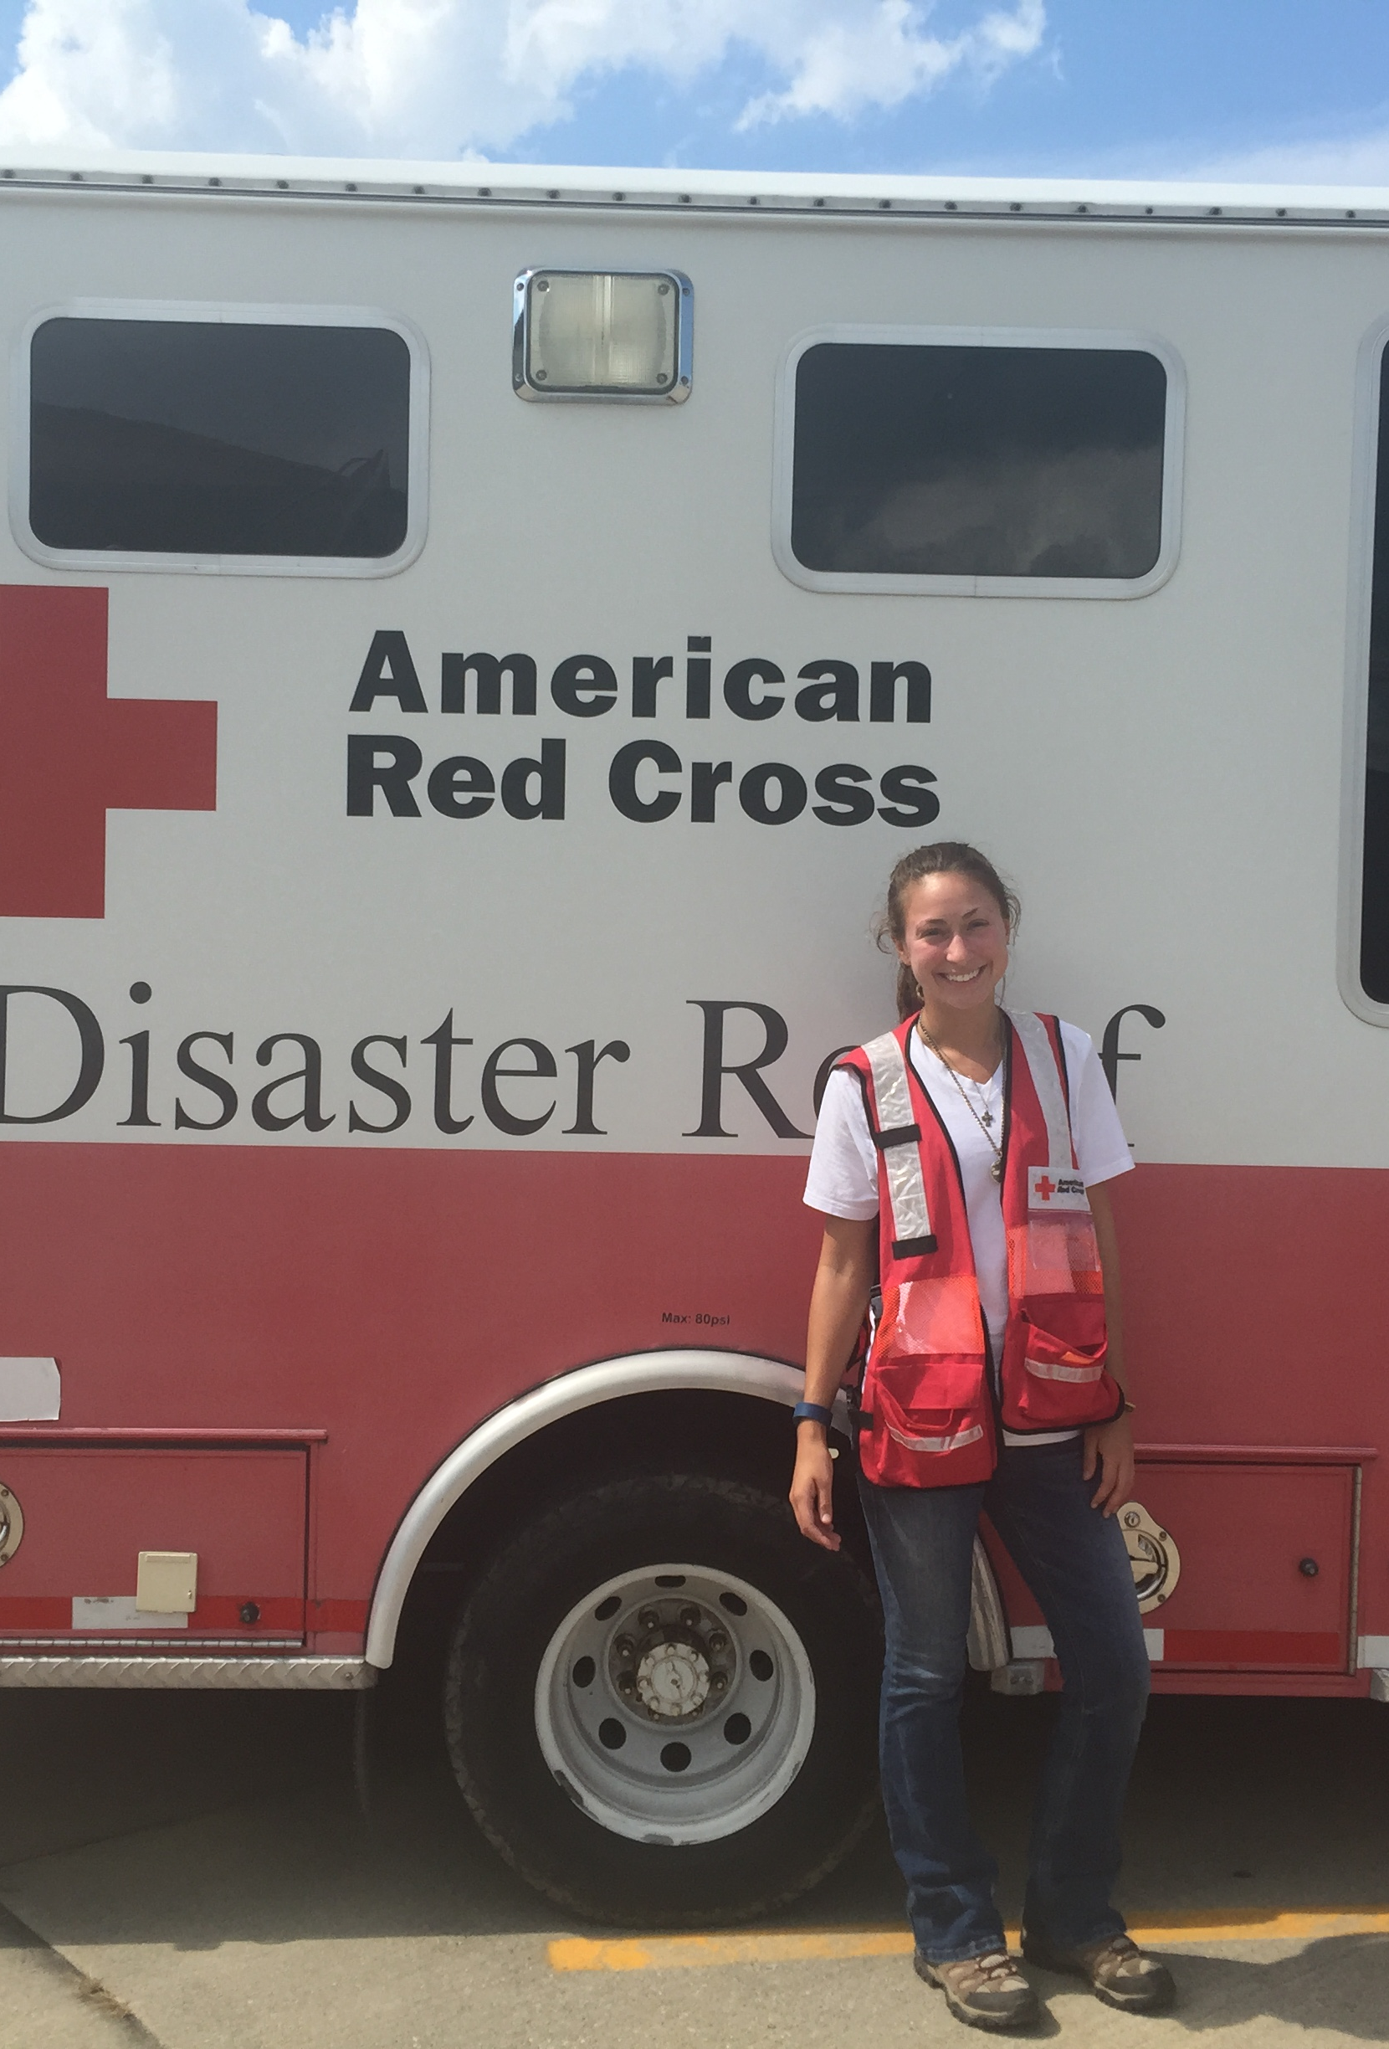
Kokomo 2016
A national disaster, home to roost

Slide 17
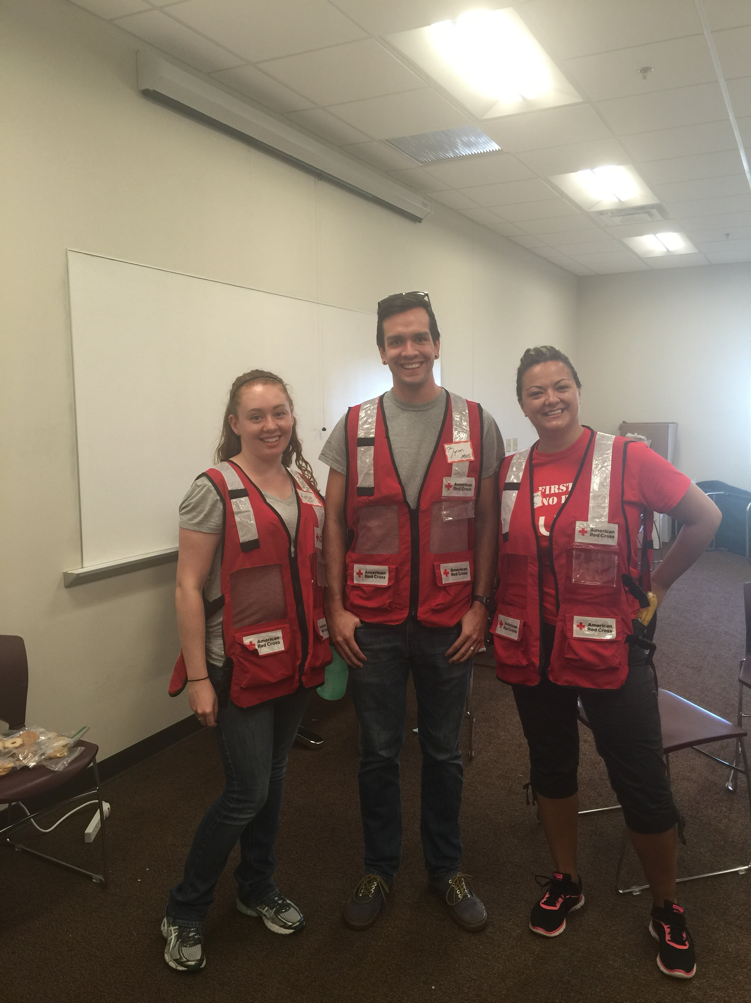

Slide 18
How can your program get involved?

Slide 19
Identify licensed faculty (or very close professionals) willing to become DMH volunteers
Make contact with the local ARC chapter; if they don’t understand, contact David Romano (D17’s current ERC) to get the name of a state lead
Plan a training session for your department; do this regularly
Volunteer your (and your students’) services to the local chapter

Slide 20
Student activities
Five of our faculty are DMH-trained
Students have traveled to Katrina and Alabama
Kokomo and Portland were national, but felt local
Students have taken calls for survivors of local disasters (fires, car accidents), even a couple of hoarding cases
Students also handled follow-up for volunteers returning from national disasters
Their energy makes all the difference!

Slide 21
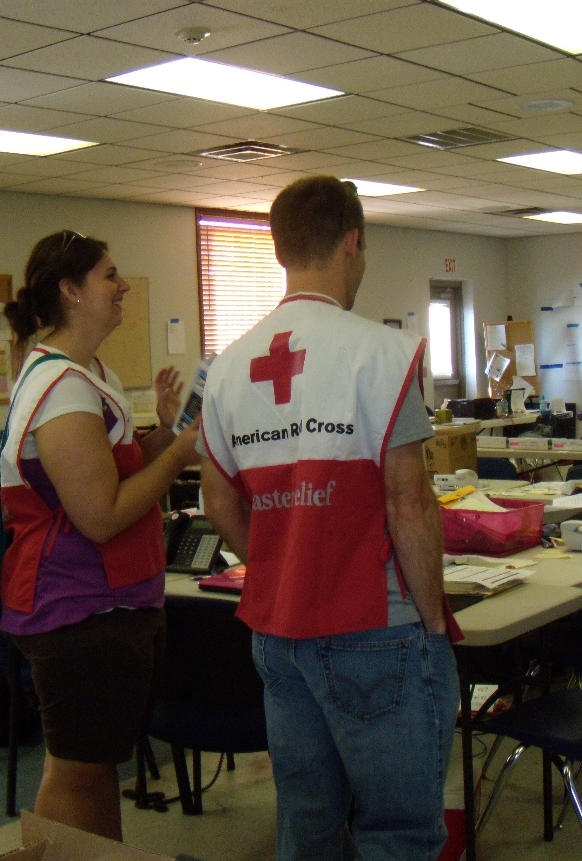
Questions?

