Slide 1
Advancing Psychology through Advocacy
Council of Counseling Psychology Training Programs Conference
February 20, 2015
San Diego, CA
Karen Studwell, JD
American Psychological Association
Notes:
Good morning Everyone. Thank you for inviting me to speak with you today. I want to say a special thank you to Arpana Inman for inviting me and bringing advocacy to the forefront of your conference this week. We are usually competing with other sessions, so I am glad there are so many of you here today. I am also glad that Arpana is going to start her role as one of our 20 Federal Education Advocacy Coordinators this year, so, I also wanted to thank her for her leadership in that role. It’s really a great example of how to take action and
Arpana mentioned making it personal- We are faced with many challenges to both the discipline and the practice of psychology. We all have our own perspectives about the challenges, but advocating on behalf of your programs, your profession, your students and your discipline, is an important part of being a leader in your field.
So how is APA addressing your issues of concern and how do we decide what issues to pursue? What have we done for you lately?
I would like to ask how many of you are APA members?
I believe my role is really to help get you thinking of ways that you can get involved in advocacy on behalf.
I also wanted to acknowledge- three of our own grassroots advocate leaders from the NCSPP ranks- our Federal Education Advocacy Coordinators, (Arpana, Cindy Juntunen)
-I would also like to acknowledge members of our Education Advocacy Trust who have been great supporters of the education legislative agenda and have allowed us to engage in additional political activities. In fact, do any of you happen to be members of the Education Advocacy Trust? If not, you will learn more about the role of the trust and how your membership and support contributes to psychology’s education advocacy agenda.
- As the world’s largest organization representing psychology, you are truly representing not just yourself, but, more than 130,000 psychologists.

Slide 2
Learning Objectives
Understand the critical role that advocacy plays in advancing your professional and personal goals
Increase your knowledge of how APA accomplishes its Advocacy Agenda through the federal legislative processes
Gain appreciation of the importance of applying psychology to education policy
Notes:
Some of you may have enjoyed our more interactive advocacy training sessions either here at CCPTP or at APA’s Education Leadership Conference. I won’t be getting in the weeds of how to meet with your Member of Congress, but, taking a 30,000 foot view of the changing landscape of advocacy and hopefully giving you some ideas about how you can take the next step. I would really like everyone to get 3 things from today- Why, What and How?
Understand Why You Need to Be Involved
Understand What APA has done for you lately
How Can you Go back and Add it to your Already Full To-Do List?
Who- if not you? And When? If not you, then who? If not now, then when?

Slide 3
Why Advocacy?
Notes:
Why Advocacy? Why is it important part of your professional identity, as a psychologist, as a citizen.

Slide 4
Top 5 Reasons Psychologists Should Advocate
5. Increases federal funding for psychology
4. Raises awareness of psychology’s contributions
3. Advances psychology as a health profession
2. Enhances psychology as a STEM science
1. Protects the future of psychology
Notes:
#5. Garner federal funding for initiatives of importance to psychology! – supports those training programs.
#4. Raises awareness of the contributions psychologists make to meeting local, state, and national needs
#3. Advances psychology as a health profession
#2. Enhances status of psychology and behavioral science
#1. Psychology is at risk- as a science, as a discipline, as a health profession
-In fact, there are many reasons psychologists need to engage in advocacy, such as the 5 described above.
-It’s also important to keep in mind that psychology is not well understood or appreciated on Capitol Hill.
-Finally, we have made a great deal of progress in promoting the contributions of psychologists…a lot more needs to be done.

Slide 5
If You Don’t Have a Seat at the Table

Slide 6
You May Be on the Menu

Slide 7
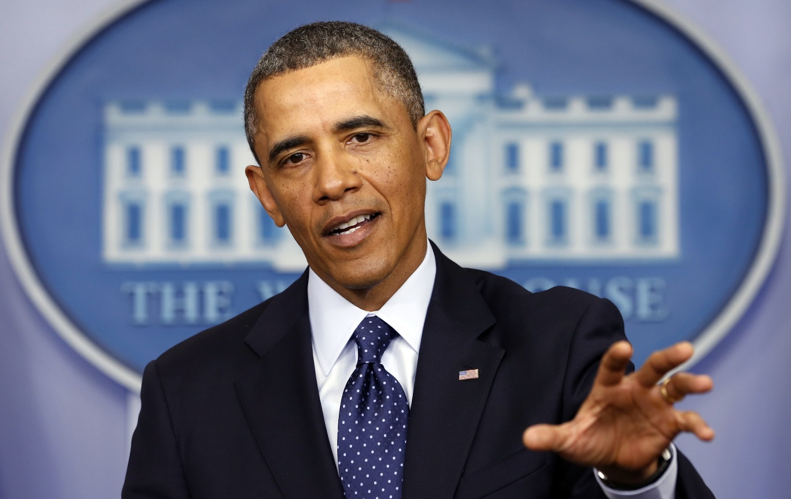
“Now is the Time” Initiative
“We are going to need to work on making access to mental health care as easy as access to a gun.” – President Barack Obama
Notes:
Example- In 2013, President Obama decided after the shooting in (Blacksburg, Arizona, Colorado and Newtown, CT) that we really needed to increase our focus on not just gun violence prevention, but prevention and treatment for behavioral health disorders in youth and young adults 16-25 years old.
He asked his mental health staff at Substance Abuse and Mental Health Services Administration how to address the workforce shortage. The resulting proposal included a $35 million to increase the mental health workforce.

Slide 8
“Now is the Time” Workforce Provision
“The Administration is proposing steps to identify mental health issues early and help individuals get the treatment they need before these dangerous situations develop.”
Behavioral Health Workforce Education and Training (BHWET) for Professionals: $35 million joint initiative with SAMHSA and HRSA to train social workers, counselors, psychologists, and other mental health professionals/paraprofessionals.
Notes:
Who was there to speak for doctoral psychology? Were we at the table? We were not even invited to the party. Where was psychology? What happens when people don’t invite you to the table?
Disaster avoided or a wake up call?
Next steps: Met with SAMHSA and they said “Only if Congress tells us to”
Talked to the White House Policy Staff- “We listen to SAMHSA”
Talked to Congress; “What’s the role of doctoral level psychology?”
In the end Congress told SAMHSA we had to be included… is that a success? Survival is no Sufficient…
The $26 million funding announcement included us, but only 10 applied. 7 got funded- 70% success rate for those that applied,. Nearly $1 million in new grants that will create more than 50 new intern slots.
This year- the President proposed a $21 million increase to the program. Our challenge is to grow our share of that program.
My point in this story is that you need to be at the table, you need to be able to pick up the phone, call the White House, call your Member of Congress and explain to them how doctoral level counseling psychology is a part of the solution to this problem. If it sounds impossible for you to follow all of the ins and outs of these proposals, then you might be better able to understand the role of a national organization that works on your behalf and when we call, they answer the phone.

Slide 9
FY 2014 Doctoral Psychology Internship Program BHWET Grants
Casa Pacifica Centers for Children and Families (CA)
Hugo W. Moser Research Institute at Kennedy Krieger (MD)
Massachusetts School of Professional Psychology (MA)
Father Flanagan's Boy's Home (NE)
University of New Mexico (NM)
Brown University (RI)
University of Vermont & State Agricultural College (VT)
Notes:
Add BHWET Slide

Slide 10
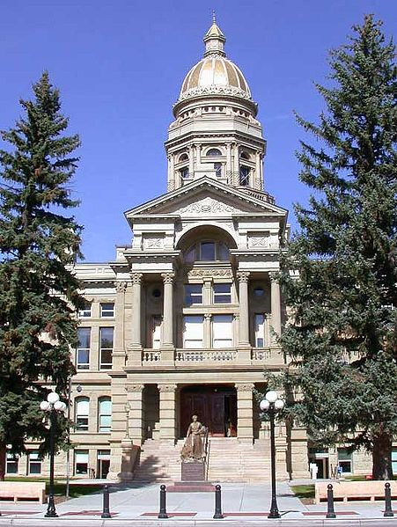
Advocacy is Needed at All Levels
Federal Level
State Level
Local Level
Notes:
10
So, that’s the why– and I will give you more info on the what and how, as that is just one example of the work we do on behalf of the discipline and practice of psychology.
While a national organization can be active at the federal level, there are certainly lots of issues happening at the state level and the local level that we do no have the resources to monitor or impact.
Some of you may be members of your state psych. Association, and I encourage you to be involved. As Congress has been unable to accomplish much the past few years, there is a lot of activity in the states and your state psych. Association is often paying attention to those issues that are impacting the practice of psychology.

Slide 11
An Overview of APA Government Relations
Notes:
11
KAREN
I am now going to give you a brief overview of APA’s government relations operations, which is the largest & most visible national presence advocating for psychology. APA represents more than 130,000 psychologists, including scientists, practitioners, educators, students, and affiliates. Each of our members has their own personal interests and expertise, so our job is really to harness that knowledge, energy and commitment into pursuing a coherent advocacy agenda.

Slide 12
APA’s Social Justice Mission
Our Mission at the American Psychological Association is to advance the creation, communication and application of psychological knowledge to benefit society and improve people’s lives.
Notes:
What is APA doing- across our Directorate’s, to advance psychology through advocacy? Our mission is broader than my portfolio and we are both deep and wide and the APA mission is to “
Our vision statement and strategic plan embraces APA as an effective champion of the application of psychology to promote human rights, health, well-being, and dignity. Our core values explicitly include social justice as well.
APA is the world's largest publisher of psychological science — publishing over 75 scholarly journals, 75 scholarly books and references each year, and creating/distributing seven scholarly databases of psychological knowledge and information. We also have well-developed campaigns to inform the public, including the Psychology: Science in Action, Mind/Body Health and Healthy Workplace programs.
We advocate vigorously for the use of knowledge from psychological science in the public policy process and for the allocation of resources to scientific research, education and access to health care. These programs are highly valued by the membership as documented in membership surveys.
APA Practice Organization (APAPO), was created to advance the professional interests of psychologists. APAPO is an important mechanism to promote guild interests and it needs our support, but its viability also rests on the respect that society holds for the discipline and profession itself.

Slide 13
Branches of Government
Executive
Judicial
Legislative
Notes:
13
-There are three branches of the U.S. federal government, including the Executive, Judicial, and Legislative branches
-The Executive Branch of Government is led by the President, and includes the Vice President, the cabinet, and the federal agencies and departments
-The Judicial branch of the federal government is responsible for the federal court system; appointees to the federal bench serve for life or until they voluntarily resign or retire; federal courts rule on the meaning of laws, how they’re applied, and if they violate the Constitution
-But, today we’re going to focus on the Legislative branch of the federal government – Congress.

Slide 14
Executive Branch Agencies
Notes:
When we say we work with the Executive Branch, we each take the primary lead on many of the agencies and Departments impact the science, discipline, or practice of psychology.

Slide 15
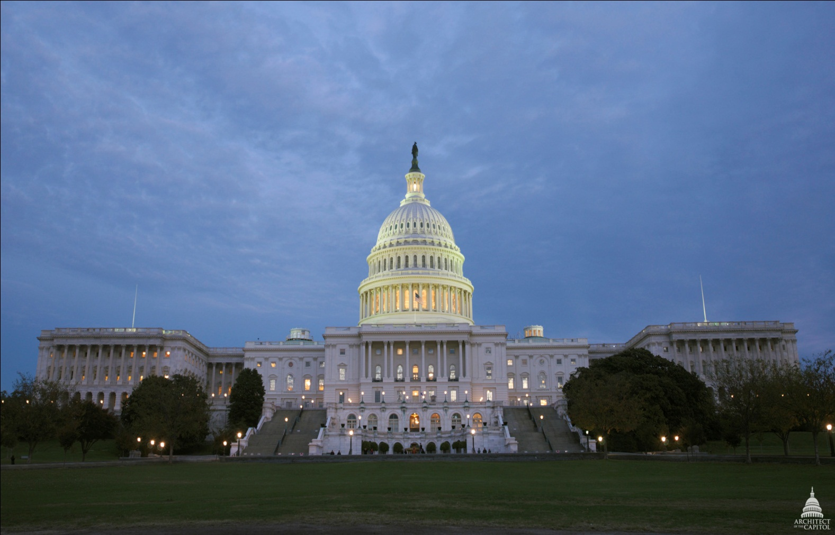
Legislative Branch
Notes:
So- How do we work with Congress and how can you get involved?
How many of you have heard of the Garett Lee Smith Memorial Act? 12 years ago, my colleague jenny Smulson worked closely with Louise Douce, Sherry Benton and others in the Counseling Psychology community to take an idea and turn that into a federal program to support college counseling centers and improve campus based youth suicide prevention programs.

Slide 16
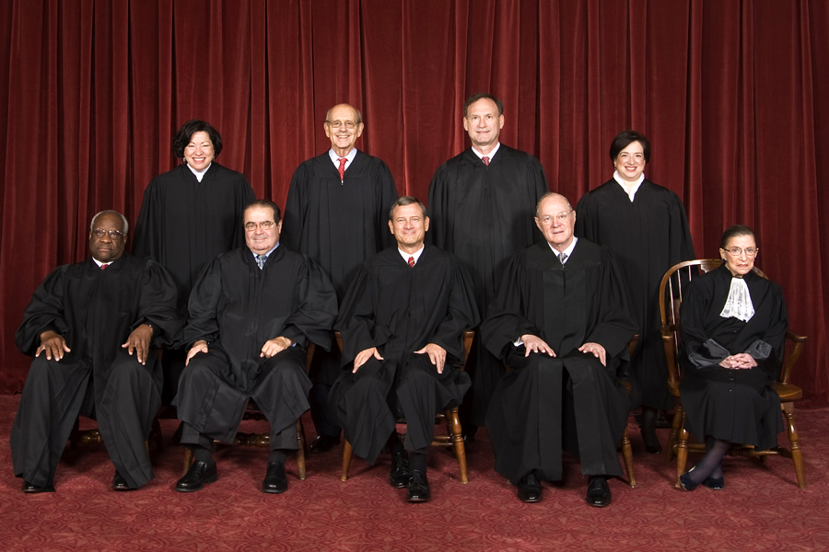
Judicial Branch
Notes:
16
-Four of the nine sitting Justices have joined the Supreme Court since 2005: Chief Justice John Roberts (2005), Associate Justice Samuel Alito (2006), Associate Justice Sonia Sotomayor (2009), Associate Justice Elena Kagan (2010)
-Three women currently sit on the Supreme Court, an all-time record for the Court.

Slide 17
Judicial Advocacy: APA Amicus Briefs
Abortion
Affirmative Action
Animal Research
Antitrust
Battered Women's Syndrome
Child Abuse/Child Witnesses
Child Sexual Abuse
Civil Commitment
Competency
Confidentiality/Psychotherapist-Patient Privilege
Copyright
Criminal Defendants' Right to Mental Health Assistance
Death Penalty
Defamation
Disabilities/Rights under the ADA
Duty to Warn/Protect Employment
Environmental Impact Analyses
ERISA
Expert Witnesses/Psychologists' Competency
Gay, Lesbian and Bisexual Parenting
Hospital Privileges for Psychologists
Insanity Defense
Medicare
Medication (Right to Refuse)
Mentally Ill and Mentally Retarded (Rights of)
Neuropsychologists' Competency
Peer Review
Psychologists' Scope of Practice/Reimbursement for "Mental Health" Services
Residential Treatment
Sexual Harassment
Sexual Orientation
Scientific Research
Tests (Use, Validity, & Security of Psychological Tests & Test Data)
Notes:
One of the historical ways that APA supports psychology is through the judicial branch as well, either at the district court or Supreme Court levels.
These briefs could address a civil rights issue, affirmative action, the death penalty, or even reimbursement for mental health services, APA has submitted amicus briefs to weigh in on issues where psychology and psychological science should be considered in determining what laws are constitutional or perhaps deserve to be overturned in the face of scientific evidence.
All of these can be found on the APA website.
-Note: A link to all briefs APA has filed can be found at the top of this slide or at: http://www.apa.org/about/offices/ogc/amicus/index-issues.aspx
While APA engages in this level of advocacy on behalf of psychology and human welfare, today we are going to be talking more about our advocacy with the legislative branch and executive branch.

Slide 18
APA & APAPO Government Relations Offices (GRO)
GRO
(Education, Public Interest, Science, and Practice)
Educating
Inform
Advise
Lobbying
Direct
Coalitions
Grassroots
Political
Activities
APAPO PAC (Practice and Education)*
Congress
Executive
Branch
*501(C)(6)
Notes:
Where is the Advocacy at APA? Everywhere…
There are 4 Advocacy Offices for science, public interest, education and Practice. lwhereas the APA Practice Organization GRO lobbies at both state and federal on issues impacting practice, such as reimbursement. We do work collaboratively on a number of issues as well, including Medicaid reimbursement for training of interns and fellows, or on cross-cutting topics of interest to all of us.
How We Do It: Advocacy can Be looked as a 3 pronged stool- Education/Lobbying/and Political Activities
GRO staff engage with both the Legislative Branch and the Executive Branch, advocating for the inclusion of psychology in federal programs and ensuring psychologists are included at the table by the federal agencies that administer those programs.
We do this in 3 ways:
-GRO staff spend a lot of time educating Members of Congress, their staff and federal officials about the role of psychologists and contributions of psychology and psychological science to a range of issues, including education, substance use and addiction, health disparities, child development, veterans mental health and chronic illness and suicide prevention.
-We cross the boundary from education to lobbying when we have a specific bill or program that we want their support for or commitment to provide funding for. We lobby Congress either directly or indirectly through coalitions of organizations with similar legislative goals.
We also lobby through our grassroots network, as Members of Congress are more interested in what You, their constituents, are concerned about than me or other APA staff, our grassroots network is critical to GRO advocacy initiatives and we will request & coordinate contacts by constituent psychologists with Members of Congress or federal agency officials (i.e. the Executive Branch).
--Finally, as already noted, since APA is a 501 (C)(3) that is prohibited from political giving, the Education Advocacy Trust (EDAT) was established as part of the Practice Organization, which is a (C)(6), to allow ED GRO staff to promote & engage in political activities (e.g., fundraisers, receptions).
APA Practice Organization (APAPO), was created to advance the professional interests of psychologists. APAPO is an important mechanism to promote guild interests and it needs our support, but its viability also rests on the respect that society holds for the discipline and profession itself.

Slide 19
501(c)(3)
501 (c)(6)
Notes:
As I mentioned, the Education Advocacy Trust is our companion organization, legally under the APA Practice Organization, that allows to complement our grassroots efforts with additional efforts in political advocacy. Just to give you an example of how that works- we spend most of our time bringing in constituents to talk about issues of importance, campus suicide, etc. but, there are some members who would go beyond the call of duty for us and we want to keep those folks in office and having those relationships ongoing is helpful so that when we pick up the phone and need something, they are responsive, they understand our issues, and we can help support those champions. It also enables us to work with the APAPO political action committee so that we can not only help you support these champions, but, enable us to broaden that from one member a year, to perhaps 10… mind you, there are 535 Members of Congress.

Slide 20
APA Education Government Relations Office
The Education GRO seeks to:
Increase federal support for psychology education and training
Promote the application of psychology to education (teaching and learning)
Notes:
20
- The goals of the Education GRO are to increase federal support for psychology education & training AND promote the application of psychology to teaching & learning.

Slide 21
APA Education Advocacy
24 New Graduate Psychology Education Grants
$7.9 Million for GPE in FY2015
7 New Behavioral Health Workforce Grant Awards
15 New Campus Suicide Prevention Awards
50 New Campus/Training Representatives
220 Constituent Hill Visits (GPE + ELC)
1,400 Grassroots Messages to Congress
365 Education Advocacy Trust Contributors
Notes:
Was we mentioned in the spring, with the unprecedented increase to GPE in January from $3 million to $6.9 million:
HRSA was able to fund 24 new GPE grants in June of 2014. By December, Congress included another milliong to $7.9 million for
2) HRSA was also in charge of implementing the workforce component of the President’s Now is the Time initiative to focus on expanding access to mental health services for transitional-age youth, adolescents, children and their families who are at risk and have developed an emotional or mental disorders.
3) The Campus Suicide Prevention programs administered by SAMHSA, provides more than $6 million in support programs across the country to expand their suicide prevention efforts and Jenny will talk more about that.
4) As we rely on an engaged grassroots Federal Education Advocacy Coordinators Network, we were also able to expand our grassroots to reach an additional 50 programs
5) We made about 220 visits with Congress on GPE funding this year, which also provides a time to explain more about the role of health service psychologists in integrated care settings.
6) We try activate our grassroots network when the timing is right, which is wasn’t for much of the year given Congress’ agenda. But when we did send out an alert, the network send 1,400 messages to Congress
7) These grassroots efforts are complemented by all of our contributors to the Education Advocacy Trust, which permits us to engage in more political activities and is a crucial part of our efforts. After the visits have been made and after the action alert, it allows us to go to a fundraiser for those individual appropriators or members. In the past year, I was able to attend events for Rep. Mike Honda and Rosa DeLauro, both serve on the House appropriations subcommittee as well as help organize the fundraising dinner that we had during ELC with Nita Lowey, the most senior Democrat on the full Appropriations Committee. Building those relationships is critical to reinforcing our messages and we hope you all continue to support the important work of the trust.

Slide 22
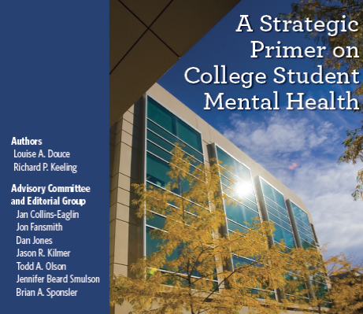
Partnership Initiatives
Notes:
“A Primer on College Student Mental Health” is complete! It has been widely distributed by each of our three organizations, has been picked up in Inside Higher Ed and will be shared through ACE’s President to President newsletter.
This “Partnership” Initiative with the American Council on Education (ACE), the Student Affairs Administrators in Higher Education (NASPA) and APA began at the urging of the VP of the United States during the WH conference on mental health held last June (3013) – and attended by Dr. Anderson. It reviews current trends in college mental health, identifies emerging issues and highlights “readiness to learn” and how mental health is integral to readiness and college completion and success.
Education GRO staff worked with key APA advisors Drs. Louise Douce, Jan collins-Eaglin, and Dan Jones, along with colleagues from NASPA and ACE.
Happy to see it complete and accessible to college and university leaders.

Slide 23
Higher Education Mental Health Alliance
The Higher Education Mental Health Alliance is a partnership providing leadership to advance college mental health
www.hemha.org
Notes:
ED GRO represents APA as part of the Higher Education Mental Health Alliance (HEMHA) along with a representative from Division 17 -- APA hosted the annual HEMHA meeting during convention. Informed and engaging discussion among member groups about advancing college mental health.
-In addition, thanks to Division 17, there was also a convention session on a new publication - Postvention: A Guide for Response to Suicide and Disaster on College Campuses which is being developed by HEMHA. It will likely be released in the coming month. You can check on the HEMHA website for more information about the Postvention guide as well as another terrific publication: “Balancing Safety and Support on Campus” A guide for Campus Teams.

Slide 24
Federal Education Policy
Elementary and Secondary Education Act
APA Recommendations on School Programs and Prevention
Academic Social and Emotional Learning Act
Higher Education Act
Student Loan Interest Rates for Graduate Students
Teaching Skills Definition (Teacher Training)

Slide 25
APA Science Government Relations Office
Share psychological research with policymakers
Enhance psychological research funding
Strengthen scientific infrastructure
Increase the ability of APA scientists to advocate for their discipline
Notes:
Hosting briefings on the psychological and behavioral research portfolios at
NIH
NSF
Protecting Peer Review and not Political Review of Research Grants

Slide 26
APA Public Interest Government Relations Office
PI-GRO engages in shaping federal policy to address the fundamental problems of social justice and to promote the equitable and just treatment of all segments of society through education, training and public policy.
Issue Areas: Health Equity, Social Determinants of Health, Criminal Justice
Priorities Include:
Aging
Children, Youth, and Families
Disabilities
Ethnic Minorities
HIV/AIDS
Lesbian, Gay, Bisexual, and Transgender Persons
Socioeconomic Status
Violence Prevention
Women
Notes:
26
The Public Interest Government Relations Office works on issues impacting underserved populations, including the groups listed on this slide. Many of these underserved populations are also represented by programmatic offices and committees in the Public Interest Directorate.

Slide 27
APA Practice Organization Government Relations Office
Protect reimbursement and consumer access to professional psychologists’ services in federal health programs
Secure laws and shape federal policy to ensure and enhance consumer access to professional psychologists’ services in the private health market
Promote the need for and inform federal policymakers regarding professional psychology
Notes:
Medicare Reimbursement
Medicare Health and Behavior Codes
Medicare “Physician Definition” legislation
Medicare Behavioral Health IT incentive legislation
Sustainable Growth Rate Repeal
State Advocacy through the State Psych. Associations
Work with Centers for Medicare and Medicaid Services in the Executive Branch and Congress on reimbursement for practicing psychologists.

Slide 28
Developing the APA Advocacy Agenda
Consistency with APA’s mission & strategic plan
Recognized expertise on policy issue
Uniqueness and importance of contribution
Support of APA governance and membership
Prospects for success
Availability of resources
Notes:
So how do we decide what issues to support? -
As we have limited time and resources and we are confronted with new policy issues all the time, we do have a list of criteria to determine advocacy priorities:
Is the issue consistent with APA’s mission and strategic plan
Are there psychologists with expertise on this issue
Can psychology make a significant contribution to the issue
Is this issue of interest/concern to psychologists
Does a legislative effort on this issue have the support of APA members
What are the chances for success with this issue
Does APA have the manpower & other resources to devote to this issue

Slide 29
Opportunities for Collaboration
Underserved Populations (ethnic minorities, Native Americans, children, older adults, low SES, victims of abuse and trauma)
Expanding Access to Mental Health Services
Prevention of Mental Health Disorders (Science, Education, Public Interest)
Psychology as a STEM discipline and a health profession
Reimbursement for Interns and Training (Practice, Education)
Diversifying the Psychology Workforce
Notes:
While there are 4 separate offices, we do overlap on some issues and collaborate when we can to make the most of our limited resources.
My colleagues in Science take the lead on NSF and Science, but, we do collaborate on training issues and on issues involving research through the Department of Education.
We are all hands on deck for recent comprehensive mental health reform legislation
In all these activities, we are working with our committees, our Boards, our grassroots advocates, to promote our issues.

Slide 30
Key Elements of Federal Advocacy
Identifying policy issues of interest
Communicating and developing relationships with Congress and the federal agencies
Providing scientific and clinical expertise to inform the policymaking process
Participating in political activities
Notes:
-So, what does federal advocacy or grassroots activity actually involve?
-Obviously, one of the first things is identifying what issue(s) or legislative initiative is of important to you (psychology);
-Once that is done, it is necessary to contact your Senators/Representative (emails, phone calls, visits);
-It also means providing expertise through written testimony or participating in hearings (Capitol Hill or in the field);
-And, it includes getting involved in political activities (campaigning, town hall meetings, political giving).
Not securing a position on your local city council– though that’s a good start to any political career.

Slide 31
How to Influence the Federal Legislative Process
Notes:
-Now that we’ve had a refresher on how the Federal legislative process works, let’s talk about influencing that process… [CLICK]

Slide 32
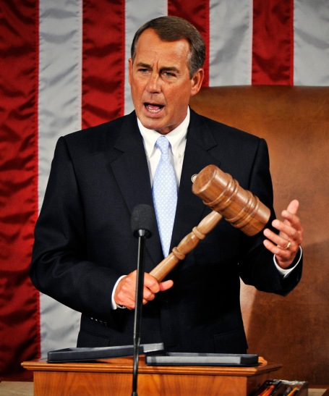
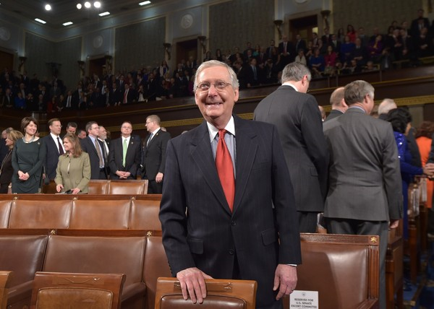
Legislative Branch
Mitch McConnell (R-KY)
Senate Majority Leader
John Boehner (R-OH)
Speaker of the House
Notes:
Now we will turn our attention to the Legislative Branch of Government, the U.S. Congress

Slide 33
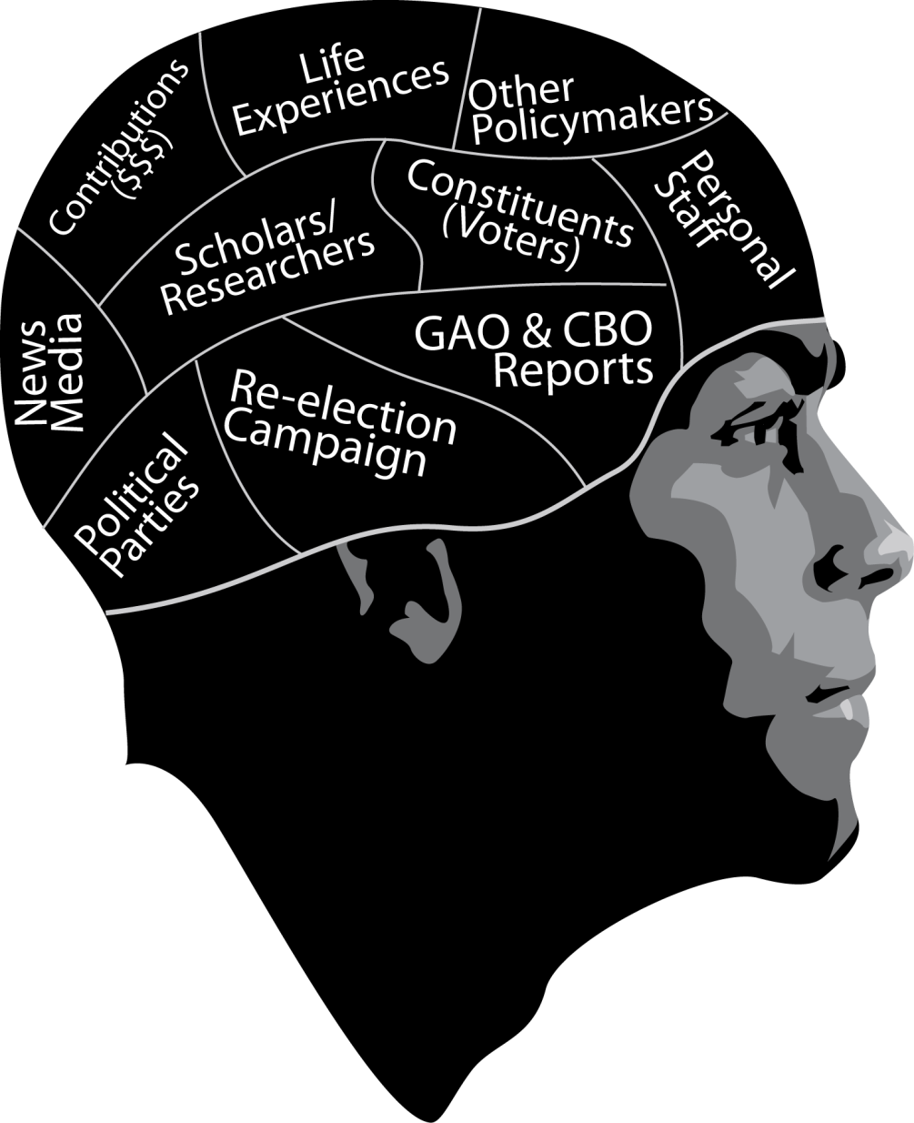
Influences on Policymakers
© APA. All Rights Reserved.
Notes:
-So, now that we see how easy it is to “make a majority” -- and for constituents to share common interests -- let’s talk about what influences policymakers.
-Of course, they are influenced by their own life-experiences, as well as the opinions of their colleagues, other lawmakers, and even their personal staff.
-Reports from the GAO (Government Accountability Office) and the CBO (Congressional Budget office) can also influence policymakers, as does information coming from the media, especially local newspapers.
-However, most influential is the information and support (contributions) that they get from their constituents; something that is especially important to their re-election efforts.

Slide 34
Why Don’t People Get Involved?
Politics is a “dirty” business
Not aware of the issue(s)
Don’t know what to say
Afraid to appear foolish
Fear of controversy
Don’t want to be asked for money
Don’t have enough time
Capitol buildings are intimidating
Don’t know how
No one asked me
Notes:
-First off, why don’t people get involved?
It might surprise you, but these are actual answers given by individuals who were asked why they weren’t involved. They gave responses such as:
“Politics is a dirty business”
“they were afraid of appearing foolish”
“afraid of controversy”
“they didn’t know who”
Or simply “no one asked them”
- However, today you’ll learn why people DO get involved

Slide 35
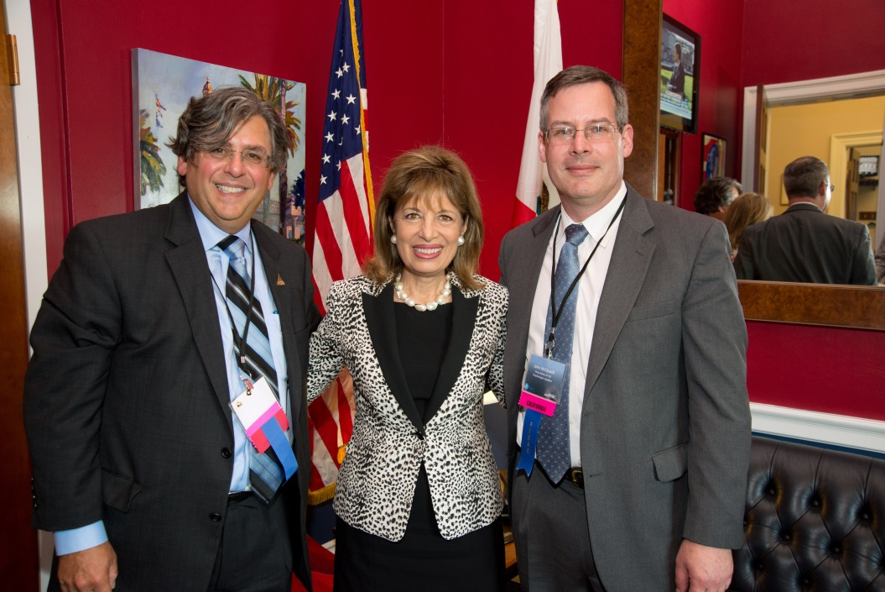
Engaging in Advocacy
Hearings
Briefings
Capitol Hill Visits
Site Visits
Receptions
Town Hall Meetings
Pictured: Rep. Jackie Speier, (D-CA) with Gilbert Newman, PhD, and John McQuaid, PhD
Notes:
-Two-way communications includes [READ SLIDE]
-However, the most effective way of communicating with a policymaker (or his/her staffer) is the “two-way” or interactive communication. Preferably in-person, but it can also be by phone.
-In fact, “face to face” time with Members of Congress (or their staff) is the “gold standard” in getting your message across.
-This can be accomplished through visits (hill or district); site visits; and receptions (fundraisers).

Slide 36
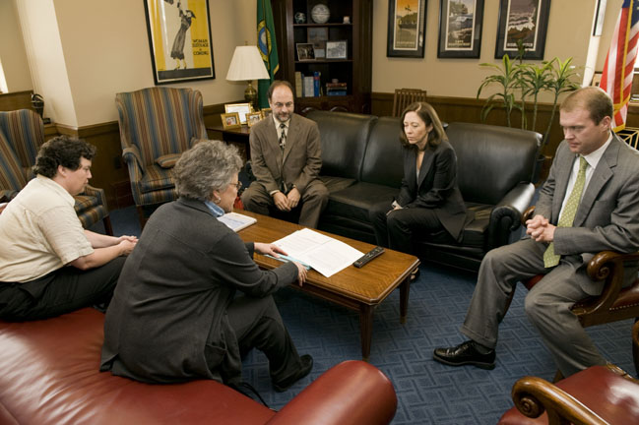
Communicating with Legislators
APA Members meeting with U.S. Senator Maria Cantwell (D-WA)
Notes:
-So now that you know how vitally important constituents are to legislators, and when is your best opportunity to influence the legislative process, let’s talk about how communicating with legislators

Slide 37
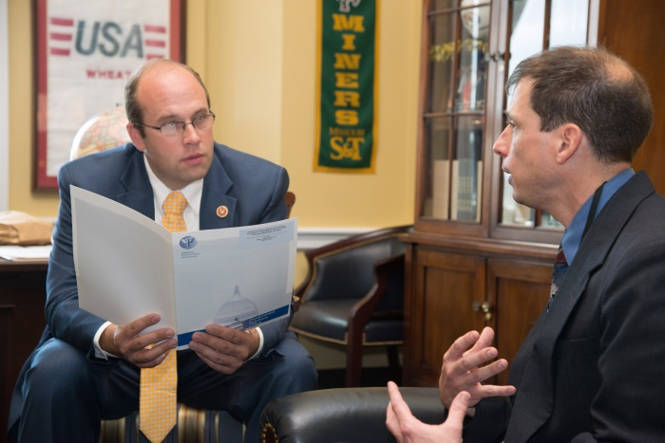
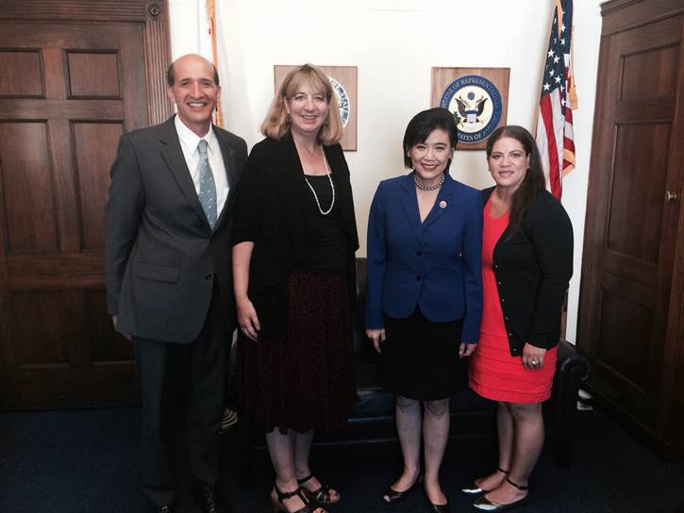
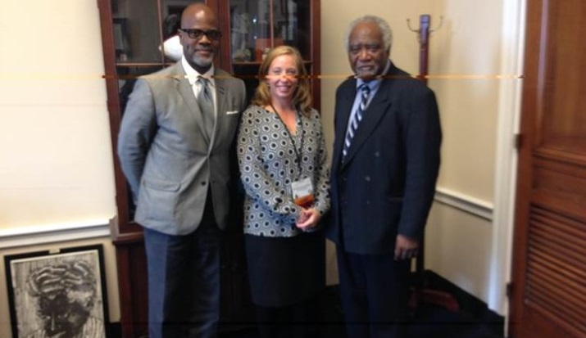
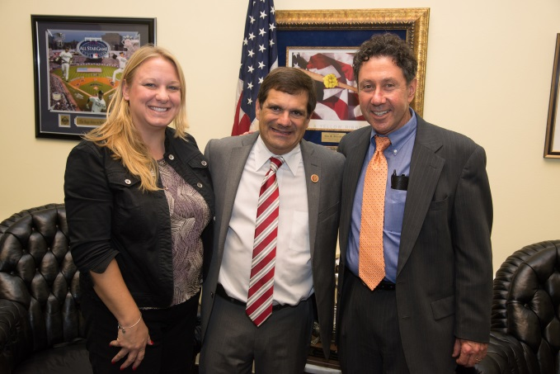
Education Leadership Conference Capitol Hill Visits

Slide 38
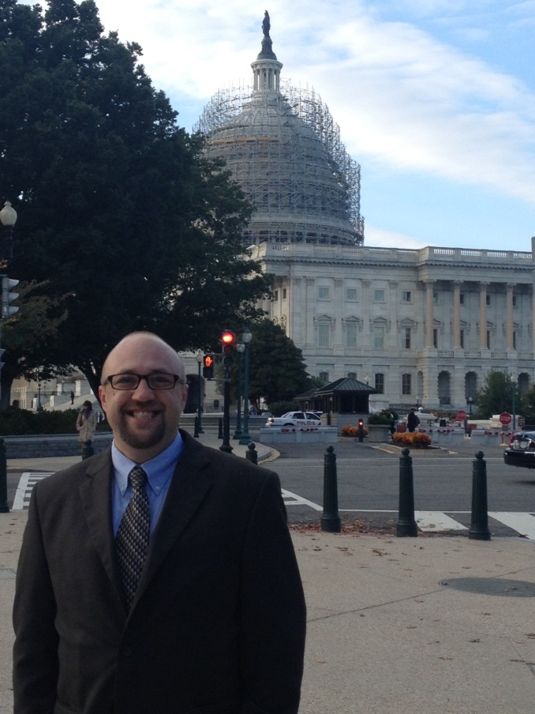
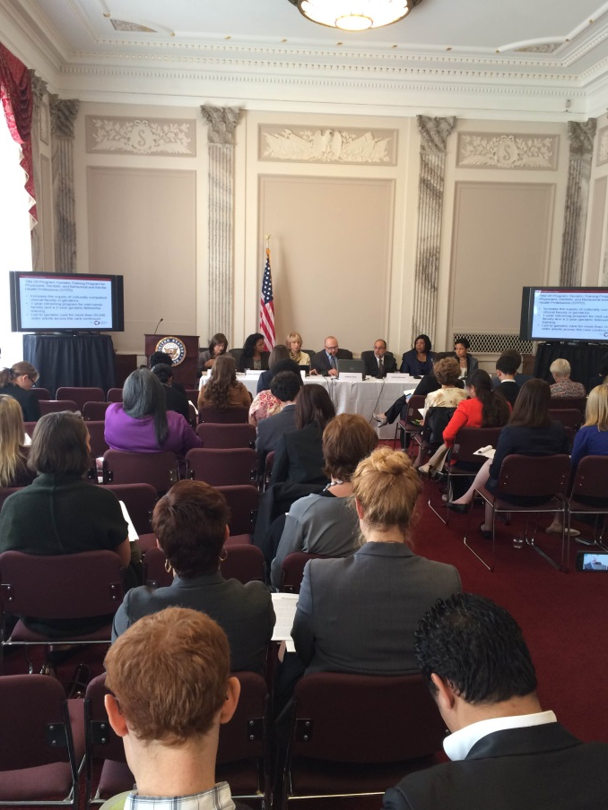
Congressional Briefing on Integrated Health Care Teams
Andrew Heck, PsyD, ABPP
Notes:
We focus a lot of our work on GPE as it is the only program that goes solely to psychologists, but there are other HRSA programs, particularly those focused on geriatrics training, that support faculty in medical schools or others working in geriatrics, and we partner with other organizations the support them. Just yesterday, we worked with the Eldercare Workforce Alliance on a Congressional Briefing with the Senate Special Committee on Aging to highlight the many health professionals, direct care workers and family caregivers that are part of an integrated health care team for older adults.
Andrew Heck, PsyD, ABPP spoke about the needs of older adults and the contributions of geropsychology to interdisciplinary teams focused on caring for older adults.

Slide 39
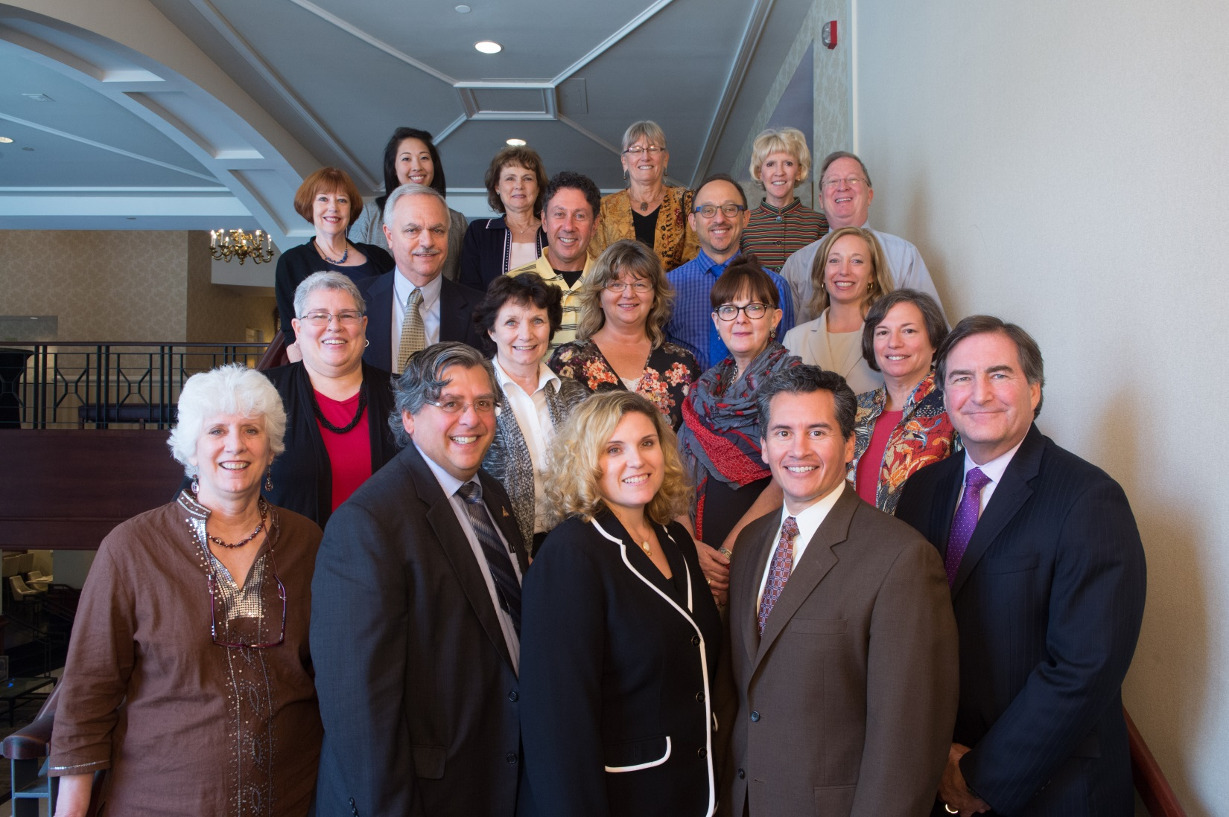
FEDAC Grassroots Leaders at 2014 ELC
Notes:
We have built a national federal education advocacy grassroots network in the Education Government Relations Office that is led by 20 leading psychologists in the education and training community.

Slide 40
Education Advocacy Grassroots Network
Notes:
-Their primary activity is to recruit network members Since the spring BEA meeting, 50 additional psychology programs/training sites have joined the FEDAC grassroots network.
-This means that we’re (approximately) 60% of the way to our goal to have a Campus/Training Representative (CTR) at all 974+ APA accredited programs and training sites. As more programs get accredited, our challenge keeps growing each year.

Slide 41
State and Local Advocacy
Notes:
41
While APA focuses primarily on federal policy, there are plenty of opportunity

Slide 42
Influencing State and Local Policymakers
Gather specific information on the issue
Develop your recommendation or “Ask”
Provide compelling data and anecdotes
Make policymakers aware of the issue/need
Identify possible supporters
Prepare for the opposition
Notes:
-In order to be able to influence state and local policymakers, just like for advocacy at the federal level, it’s necessary to begin by gathering information on the issue and develop a specific recommendation or ASK.
-As I’ve mentioned, it’s especially worthwhile to provide anecdotes and if possible, some data.
-Also it is very helpful to identify those that support your position AND those that oppose it. Why the opposition: to determine extent of challenge as well as ways to neutralize their position

Slide 43
Local Advocacy Includes:
Contacting local professional associations
Advocating for institution involvement
Gaining support from third parties
-Community groups
-Religious groups
-Local organizations
Notes:
-Local advocacy may involve getting in touch with other professional associations and forming coalitions.
-It also means advocating for support from your colleagues or officials where you work.
-And, it could include seeking support from community (HOAs) or religious groups and/or local organizations (PTAs).

Slide 44
Getting More Involved
Attend a town hall meeting
Volunteer for a political campaign
Participate in a political fundraiser
Support a Political Action Committee (PAC)
Notes:
-So, how can you get more involved? [READ SLIDE]

Slide 45
How Can You Help Make Sure Psychology is at the Table?
Notes:
-So, how CAN you make sure psychology’s at the table?
-By getting more involved though political activities. If you are not at the table, you may be on the menu.

Slide 46
Support a Political Action Committee
Notes:
-Another way to get more involved is to support a Political Action Committee (PAC)
-PACs have been around since the 1940s (President Roosevelt) and were enacted into law by Congress in 1971 with the passage of the Federal Election Campaign Act.
Gain direct access to legislators and maintain that access in order to keep your issues active/relevant
-Educate legislators about the value of psychology and its contributions to health, education, the economy, etc.
-Engaging in political activities enables you to support legislators who share your personal and professional priorities.
-Being involved in political activities is essential for the success of our democratic approach to government.

Slide 47
Why Support a Political Action Committee (PAC)?
Enable many individuals to speak “as one”
Have a greater impact by “pooling” individual donations to support a common cause
Expand your influence by supporting other legislators who share your interests
Source: Personal Political Power: How Ordinary People Get What They Want from Government, Joel Blackwell, Issue Management Co. LLC May 2001
Notes:
-So, in fact, supporting a PAC is your legal right.
-As Joel Blackwell, the Grassroots Guy, points out, PACs provide an open, honest system for supporting political candidates who are supporting your interests.
-PACs provide a means for individuals with common interests to join together to express their concerns and speak with one strong voice by supporting political candidates.
-PACs enable individuals to have a greater impact by working together to “pool” individual donations to support a common cause.
-PACs expand your influence beyond your own political district (i.e., provides support to other Legislators who support your interests).

Slide 48
Psychology’s PAC
APAPO-PAC is a powerful and effective advocacy tool that provides psychology a unique opportunity to contribute to campaigns, initiate policy discussions at fundraisers, educate Members of Congress, and directly advocate important issues to those Members of Congress who create the legislation that directly impacts your profession.
APAPO-PAC is the only PAC that supports psychology on issues such as graduate psychology education
WWW.APAPOPAC.ORG
Notes:
We really see the PAC as one part of the three-legged stool and have been able to engage in a small bit of advocacy with the APAPOPAC.

Slide 49
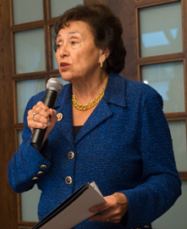
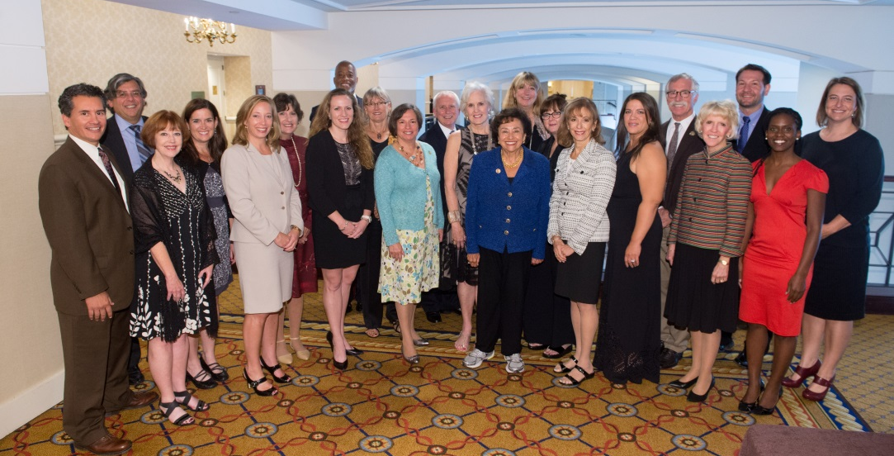
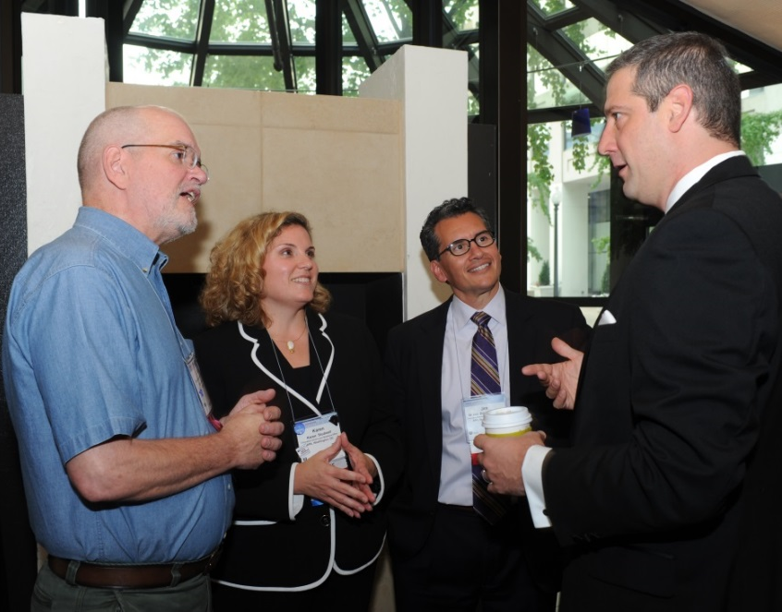
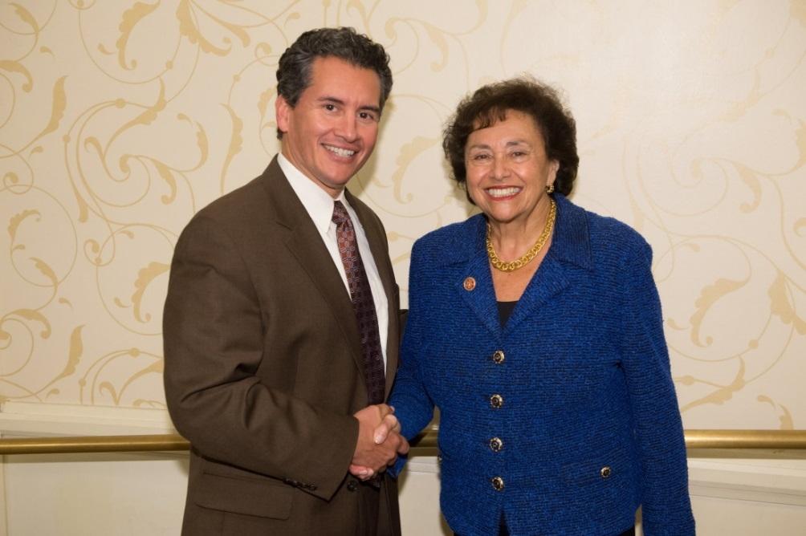
EDUCATION 2014

Slide 50
What Was Learned?
Why Advocacy is Important to You and Your Profession
How APA Advances Psychology Through Advocacy
Value of engaging in political activities
Notes:
[READ FROM SLIDE]

Slide 51
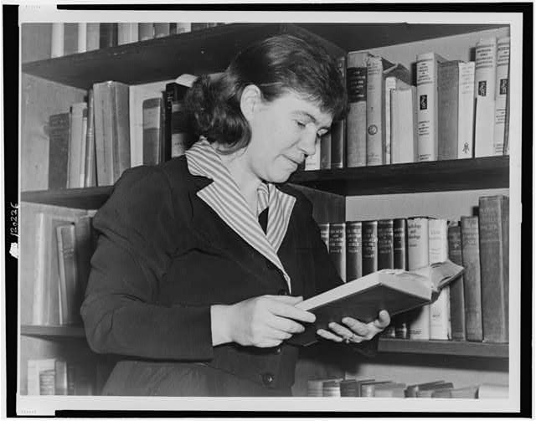
One Last Thought
“Never doubt that a small group of thoughtful, committed citizens can change the world; indeed, it’s the only thing that ever has.”
Margaret Mead

